Slide 1


User Interface Guide
Prepared for:
Introduction
This document highlights the Crestron User Interface and associated functionality.

Slide 2
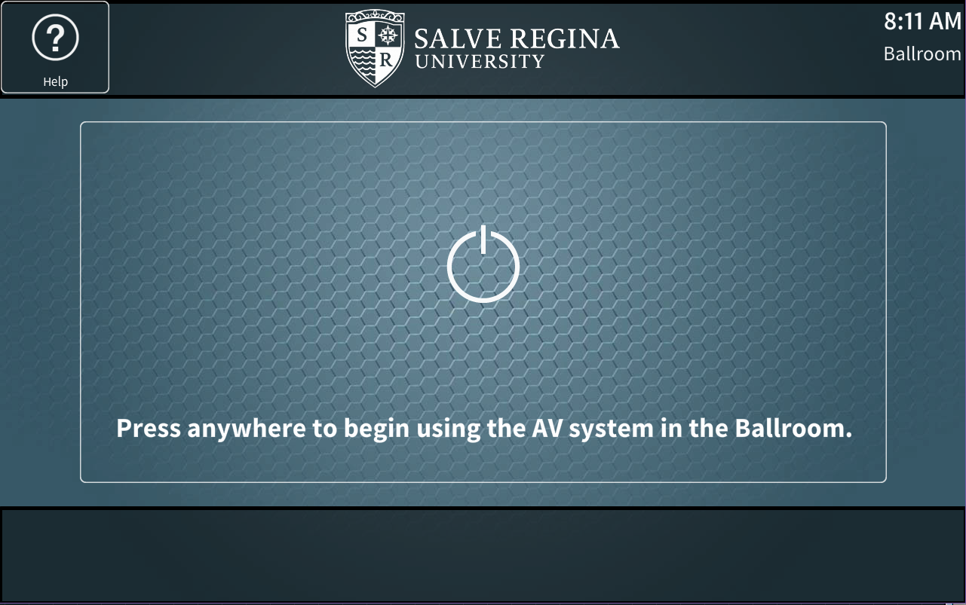
Getting Started
The default logo page when the panel is not in use.
The user can touch anywhere on the screen to begin using. The text displayed on the touch-panel will be adjusted to reflect the room the unit is installed in. In the case of the iPad the text will change based on which room the iPad is currently controlling.

Slide 3
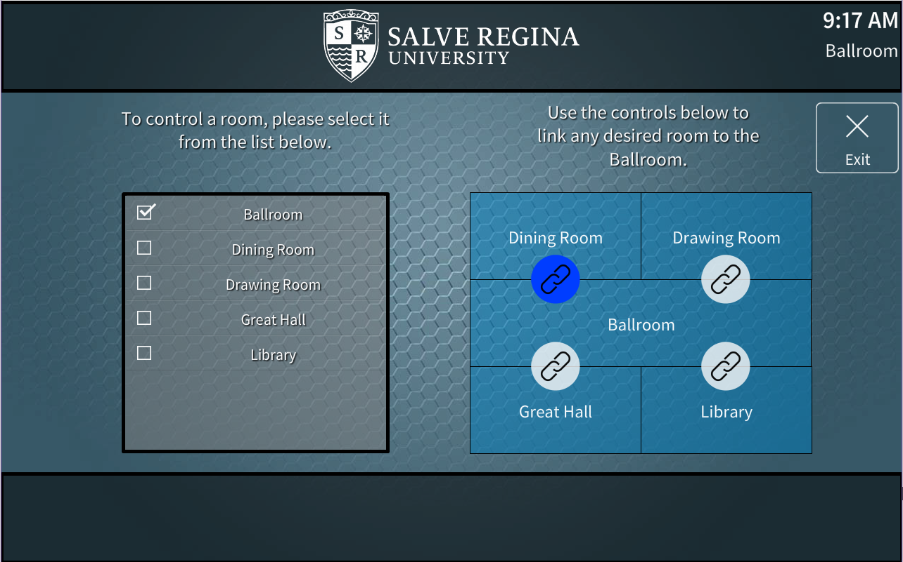
Enabling Linked Rooms
The Ballroom can be linked with other rooms in the building. Enabling a link between two rooms will cause all microphone & program audio [audio from Bluetooth wall-plates, and in the case of the Ballroom, the connected laptop or pc] to be shared between the two rooms. There are no video endpoints in any room other than the Ballroom, so video from that room will not be visible in the other rooms. The panels will show a message when linked to indicate to end users their microphone audio may be heard elsewhere in the building.
In this example, the Ballroom is overflowing to the Dining Room.

Slide 4
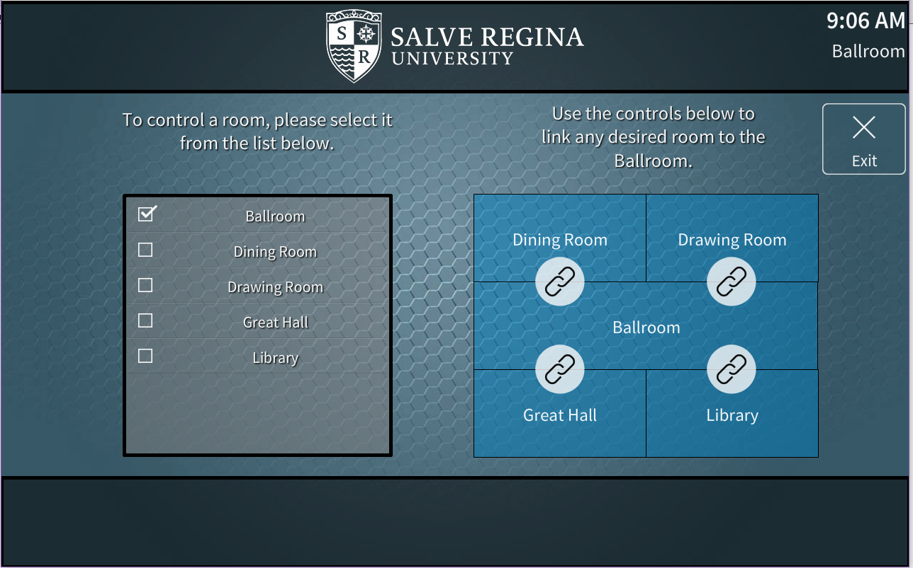
Disabling Linked Rooms
To un-link or disable overflow, touching the chain/link icon between the desired rooms will unlink the rooms. When this occurs, microphone & program audio will only be played back in the respective room. This leaves the rooms ready for breakout meetings to occur.
In this example, all rooms are independent.

Slide 5
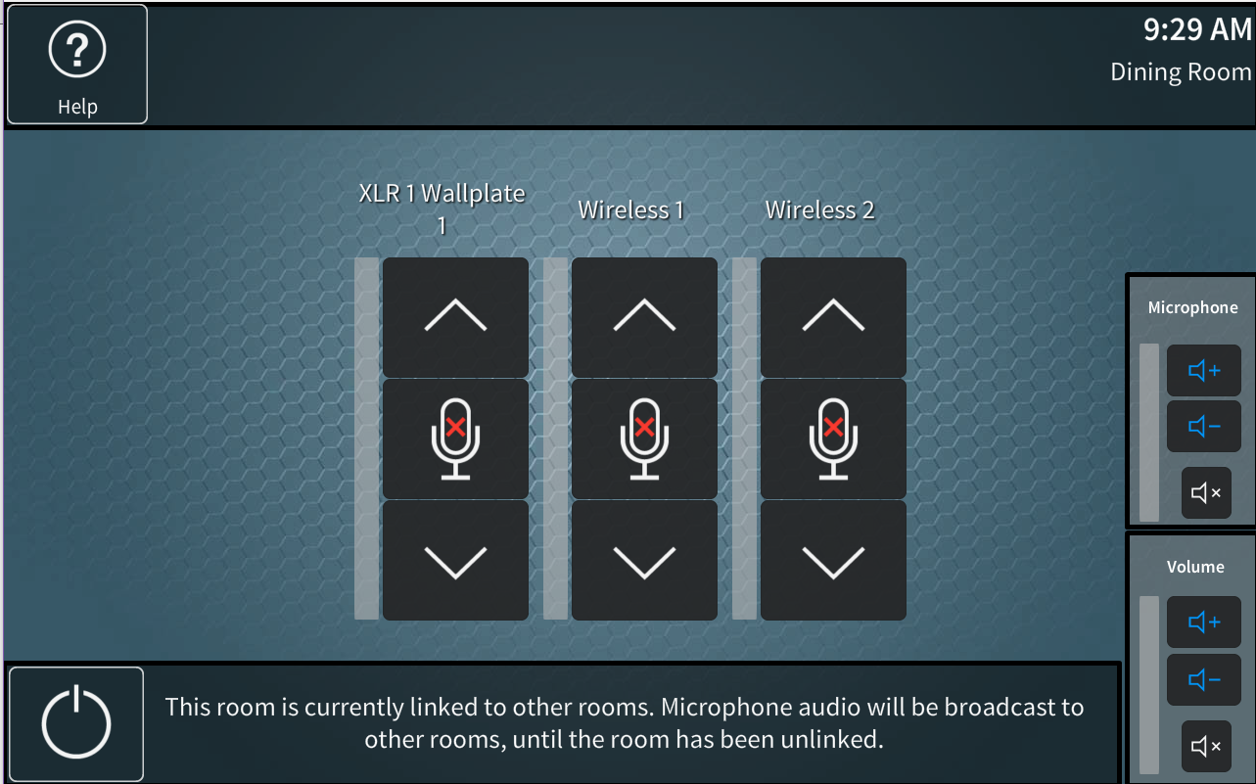
Room Linked
Any room included in a link will display the following message to indicate that audio being played back by the user could be heard in other rooms.

Slide 6
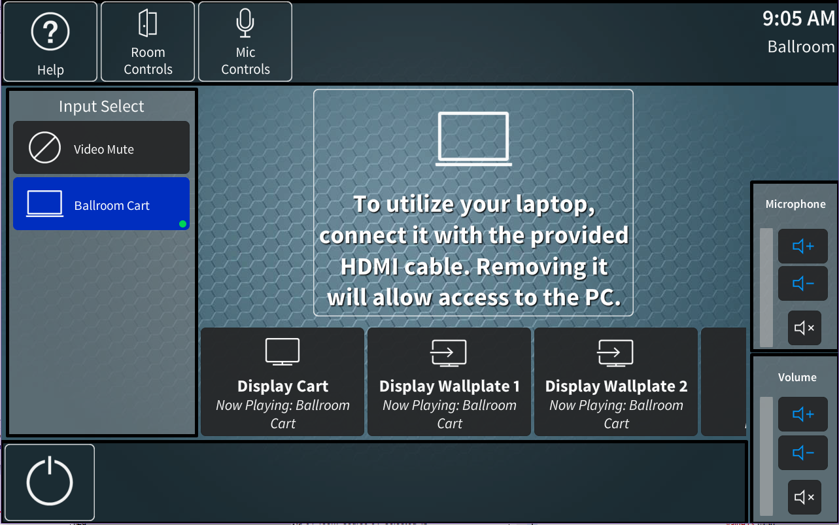
Source Selection & Routing
The user interfaces in the Ballroom, [or the iPad/Hallway when the Ballroom is selected] will have their available sources display on the left column. The available destinations will be shown in a list towards the bottom. Depending on the room, scrolling right or left using a swiping motion to see all destinations may be required. To route a source, a user will select the source the desire, then press the destination they desire. If this destination is a video display or projector the display will turn on, and if applicable, the projection screen will also drop.

Slide 7
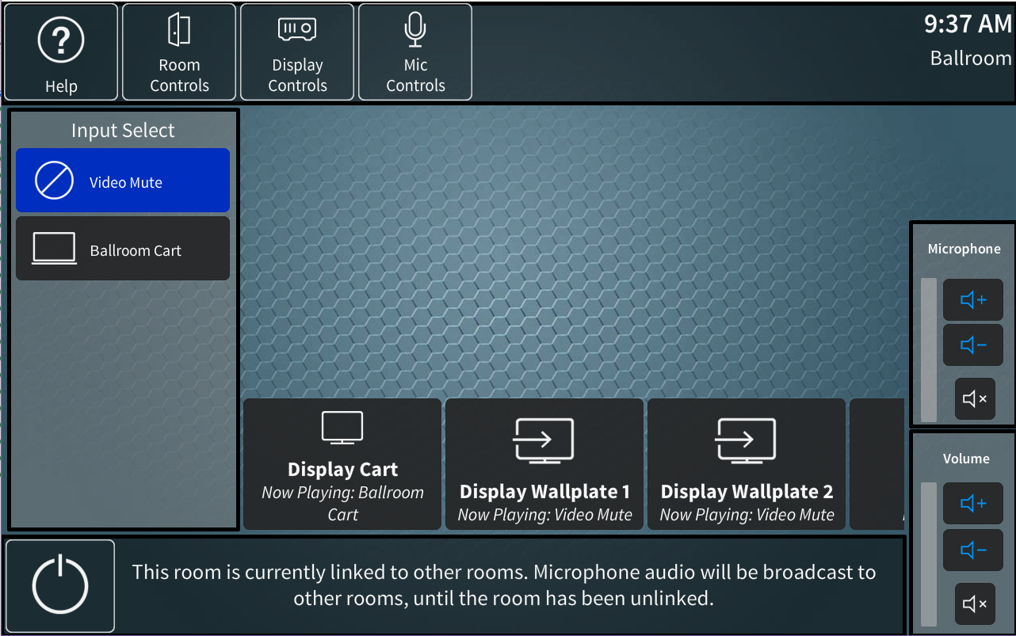
Additional Control Pages
The user interface will have several different pages depending on the equipment available to the room in which it resides. The iPad is the only interface with access to the room controls page. The possible pages are: Help Room Controls [iPad/Hallway only] Display Controls [Ballroom/iPad/Hallway Only] Mic Controls These pages are accessed using the buttons on the header bar and are discussed in the following slides.

Slide 8
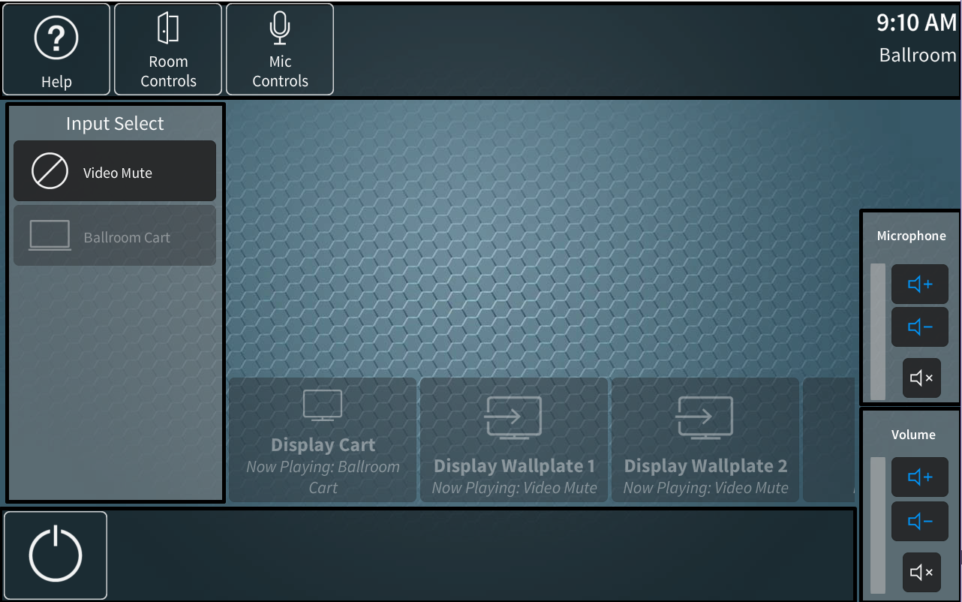
Status Indicators
The source list and destination list in each room change depending on the status of the endpoint. If a source or destination is not plugged in, powered on, properly connected or otherwise unable to communicate with the av system, it will be a slightly transparent grey color. If a source is online, it will be displayed with a dark grey background. To indicate to a user their device is properly connected, a small green circle will be shown on any source with a valid input signal.
In this example, the Ballroom Cart and all the destinations are offline.

Slide 9
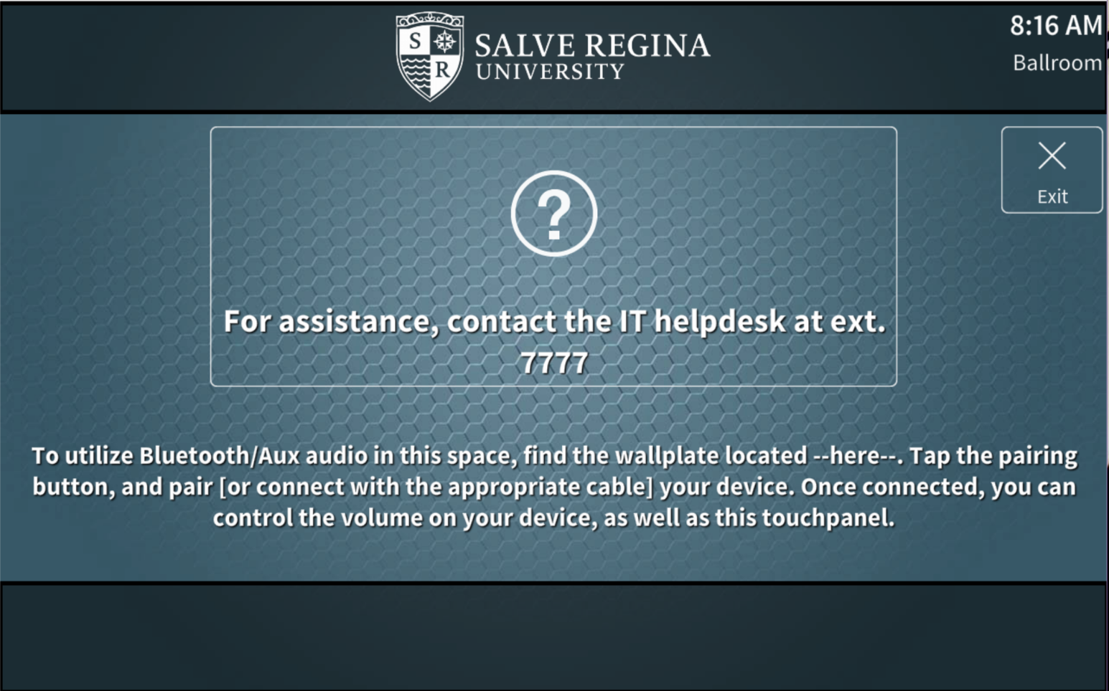
Help
The help page will have the standard help message. In addition, a small set of instructions indicating the location of the Bluetooth wall-plate will be shown to help users utilize this device. The Bluetooth wall-plate will be heard in the room it is installed, if a phone is correctly paired, and the source volume fader is un-muted.

Slide 10
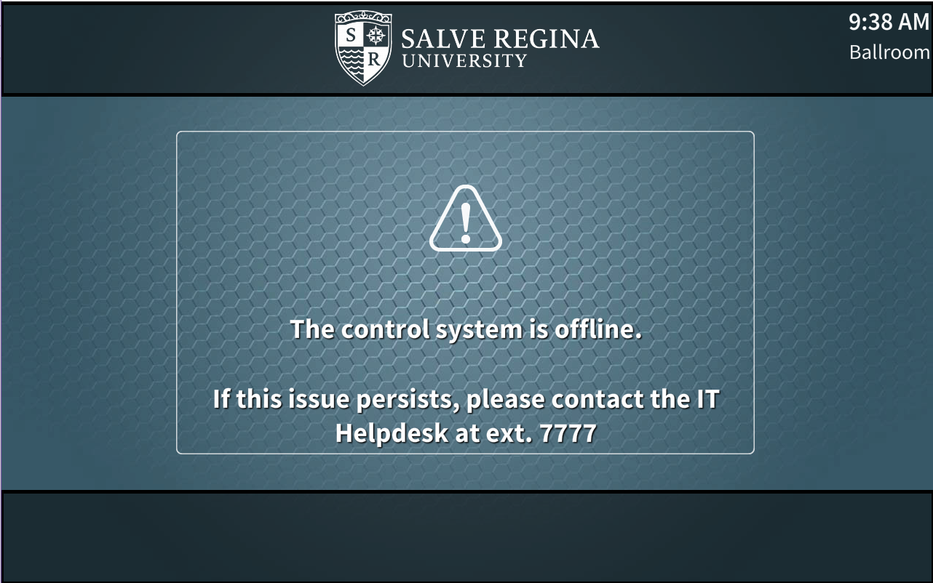
Offline
The offline page should only be visible to end users in the unlikely event that the touch-panel has been disconnected from the control system. This should only occur on touch-panels installed on mobile carts which may be moved from time to time. If this page is shown a network or connection error has occurred.

Slide 11
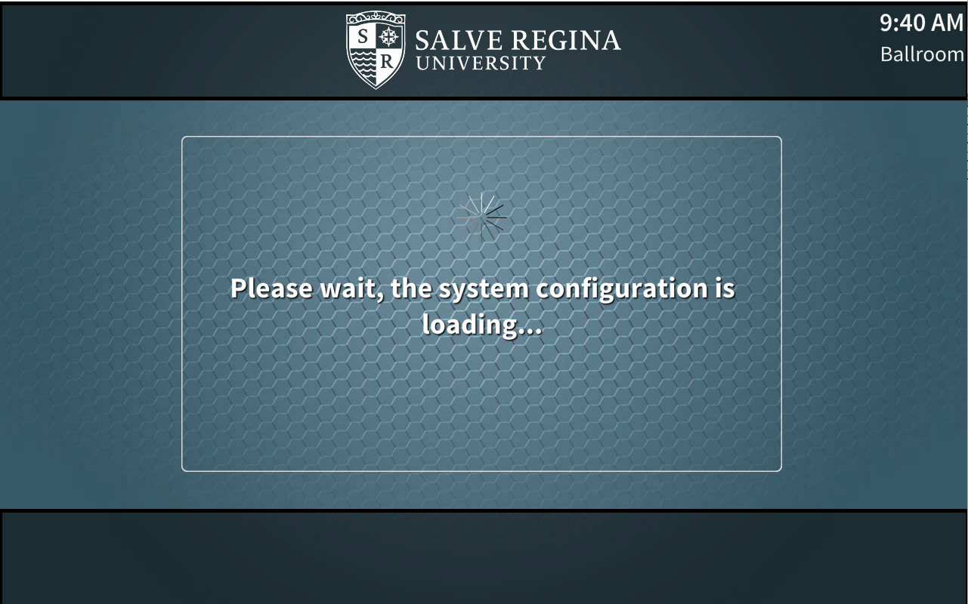
System Loading
The system loading page will be shown when the av system first boots, as it loads the necessary details and configurations. Once this occurs the page should be hidden, and normal operation should resume.
If this page is shown at any other time, an error has occurred.

Slide 12
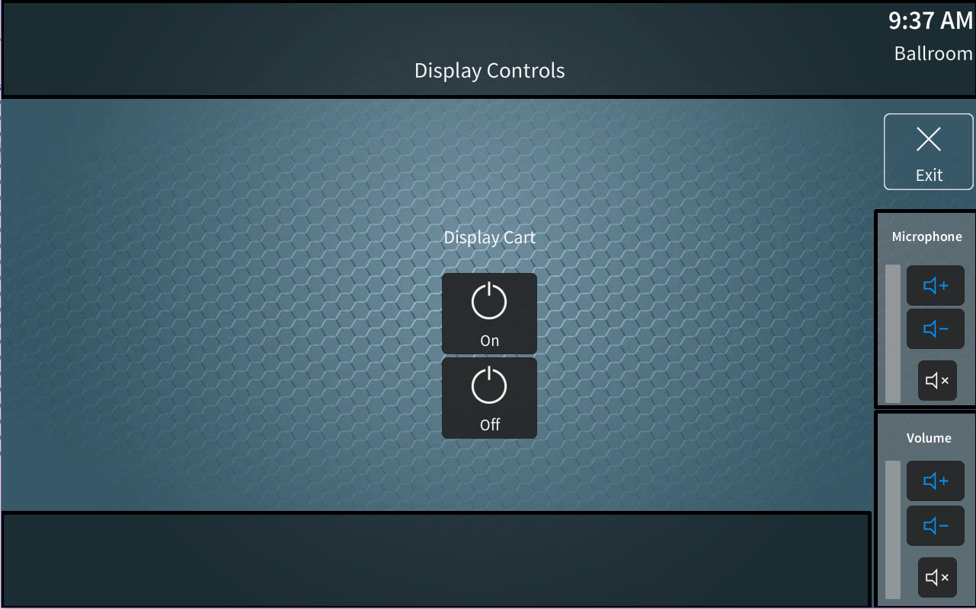
Display Controls
The display controls page will allow end users to manually turn displays on or off. They can also raise and lower projection screens [if applicable]. This should only be required if for some reason a display did not turn on automatically, or if an end user otherwise wants a display powered off without turning the entire system off. This page will only be available when the iPad or Hallway touch-panel is controlling the Ballroom, or when using a touch-panel installed in the Ballroom.

Slide 13
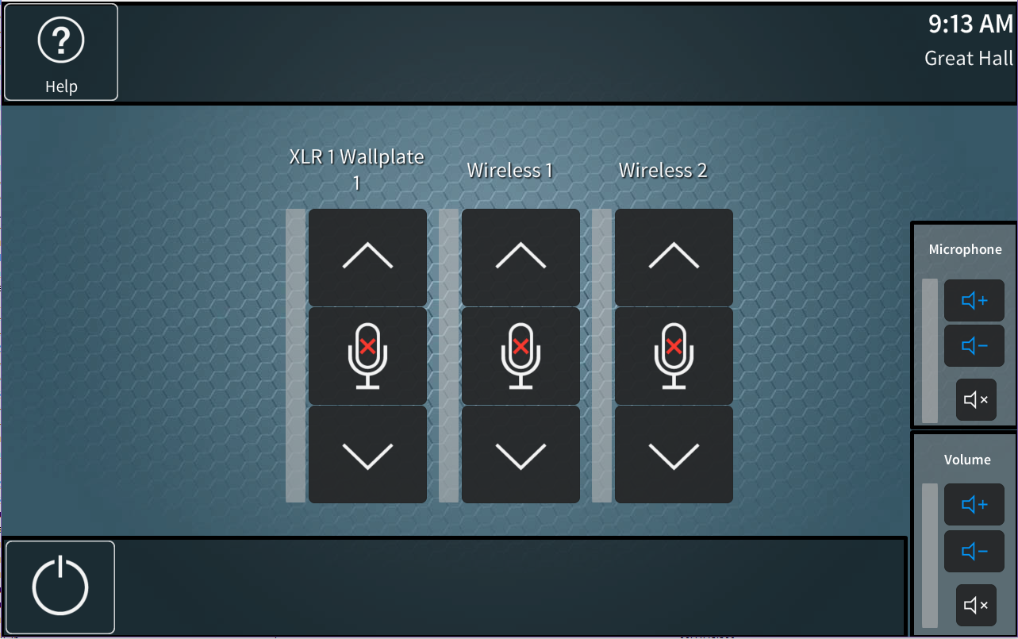
Microphone Controls
When in the Ballroom, a microphone controls page will be visible. All other rooms [Great Hall, Library, Dining Room, Drawing Room] will show the microphone controls by default on their main page as there are no video routing controls.

Slide 14
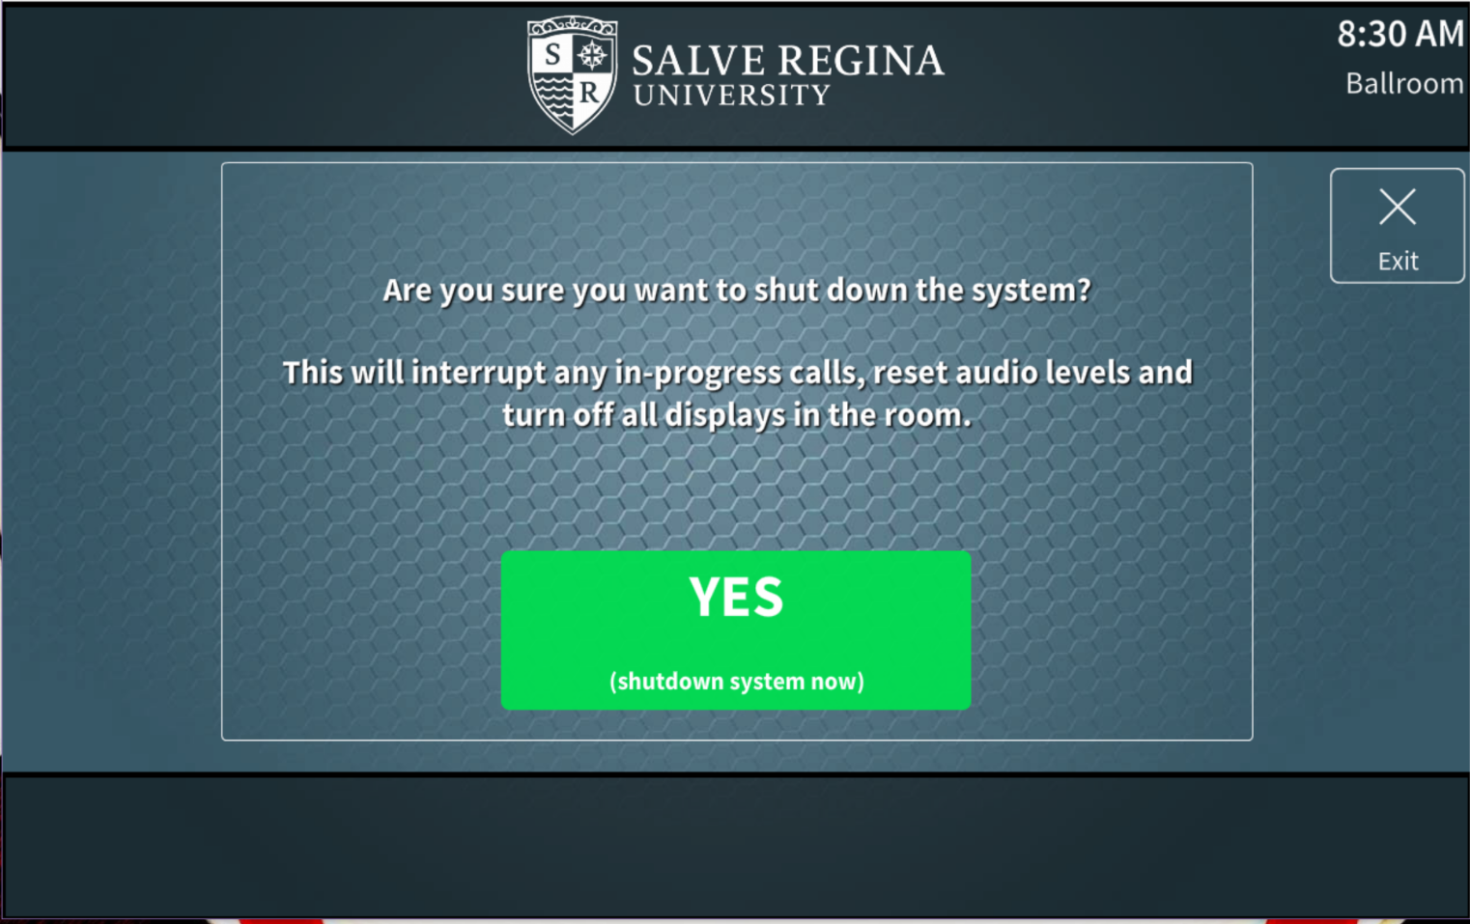
System Off
The system off page will ask the user to confirm if they truly wish to shutdown the system to prevent accidental shutdowns or interruptions of audio/video presentations. To shut the system down, the green button is pressed. To cancel the shutdown, and continue using the system, the exit button can be pressed, which will return the user to the main screen. In the case of the Ballroom, when the room is shut down, it will automatically release all rooms from overflow mode, but not turn them off, to allow users to continue any breakout meetings that may need to occur.

